Slide 1

Data Structure Design
Implementation & Data Collection
Wonhee Cho
Student ID: 20153129

Slide 2
Contents
Data Collection
UML Diagram
Implementation(Overall Codes, Key Functions and Algorithms)
Current Progress
Change of Plan & To-Do List
Q&A

Slide 3
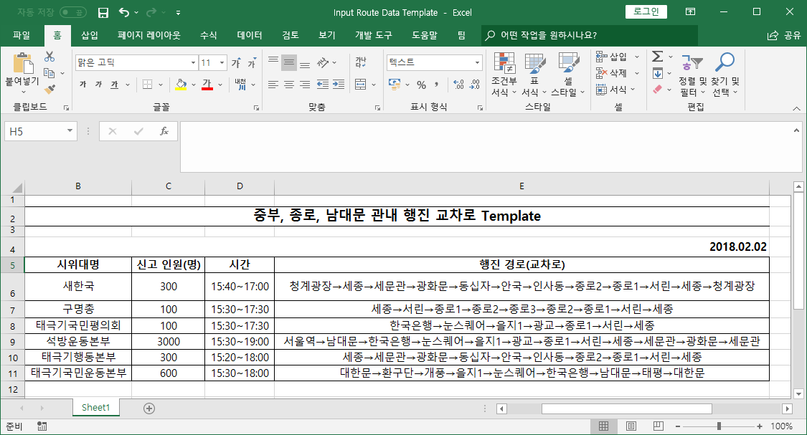
Data Collection
1. 서울지방경찰청 오늘의 집회 시위
http://www.smpa.go.kr/user/nd54882.do?View&uQ=&pageST=SUBJECT&pageSV=&imsi=imsi&page=1&pageSC=SORT_ORDER&pageSO=DESC&dmlType=&boardNo=00213973&satisfact_score=5&satisfact_score=4&satisfact_score=3&satisfact_score=2&satisfact_score=1&satisMenuCode=www&satisMenuTitle=%EC%98%A4%EB%8A%98%EC%9D%98%20%EC%A7%91%ED%9A%8C/%EC%8B%9C%EC%9C%84&satisMenuId=nd54882&returnUrl=http://www.smpa.go.kr:80/user/nd54882.do
2. 서울지방경찰청 종합교통정보센터
http://www.spatic.go.kr/article/view.do?articleId=6379&searchSelect=title&searchValue=2%EC%9B%94+3%EC%9D%BC&boardId=4&menuId=21&currentPageNo=1
3. 기타 출처(구글 검색 등)
http://m.yna.co.kr/kr/contents/?cid=AKR20180202096100004&site=hl2

Slide 4
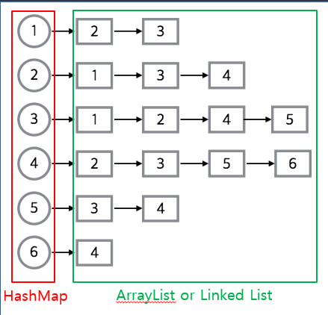
Change of Plan
전체 지도 (Node, Edge Class X)
Map<Node1, Map<Node2, Integer>>
Node1 → Map<Node2, Integer>
Accessing process is the Edge.
Only need Node1, Node2, Weight.
What’s important is :
시위대별 행진정보
private static Map<String, ParadeInfo>
Nodes(Circle) + Edges(Arrows) on Jpanel
Only Nodes on Javafx
(Model)-View)-(Controller)
(Model)-(ViewController)

Slide 5
To-Do List
Refurbish Head-Tail Visualizing codes
Find Police Barricade Intersections using Dijkstra algorithm (In progress intersections to destination intersection)
Find Police Force Deployment Intersections using Closeness Centrality
Overall Exception Handling
Optimize all codes...

Slide 6
Q&A
Problem Definition and Modeling

